Slide 1
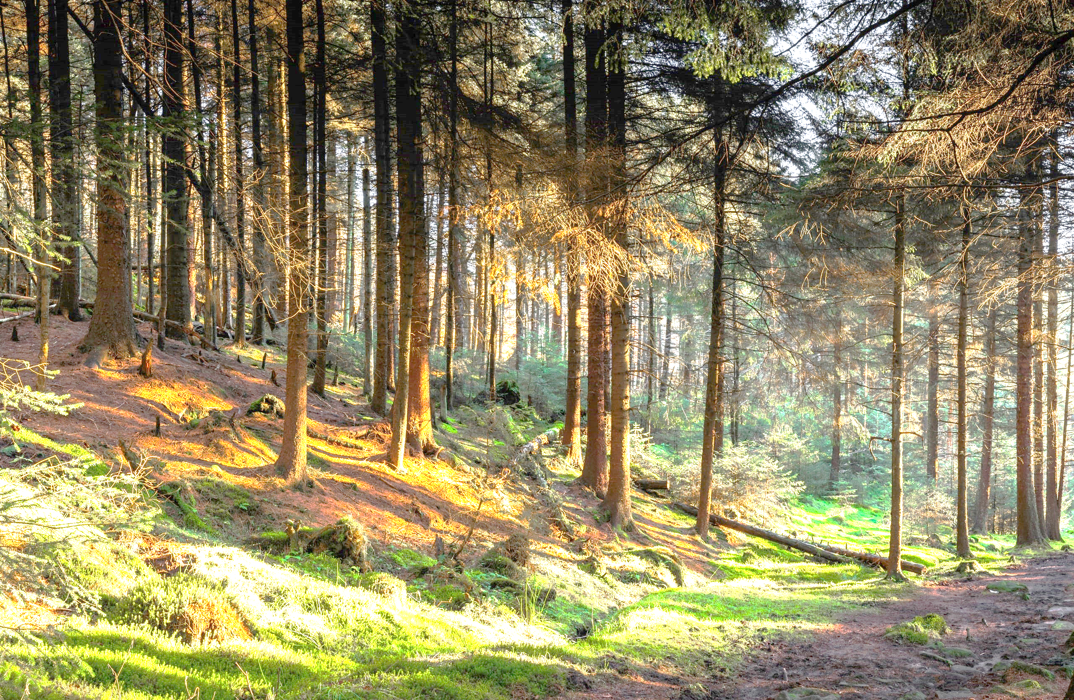
Snättringe SK TOPP232023 Kick-Off

Slide 2
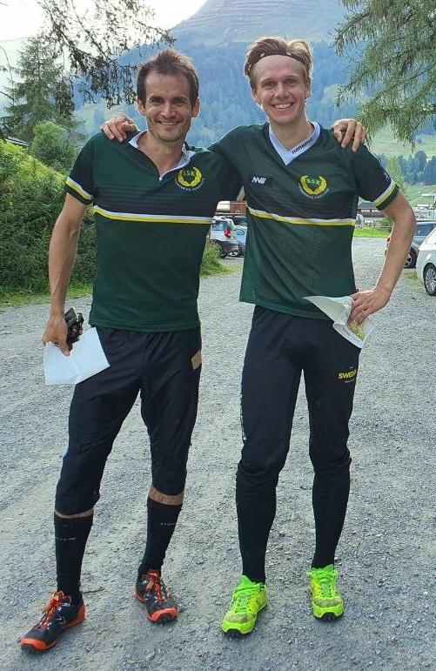
Who is talking to you about TOPP232023?
Flavio Poltera
37, from Switzerland, SSK-Member since 2016, Mapper.
Simon Hector
25, running for SSK since he started orienteering, Student.
Both part of UK Men and Träningscomitee

Slide 3
Video
Video TOPP232023

Slide 4
Goal
Top 23 men 10mila/Jukola
Top 69 women 10mila/Jukola
Top 23 25manna 2023
Five teams 25manna 2023
Many relay teams DM
Individual results

Slide 5
Where are we right now?
How far are we from our goals?
How much do we have to improve?
Who do we need to be part of this project?
How can people get involved?

Slide 6
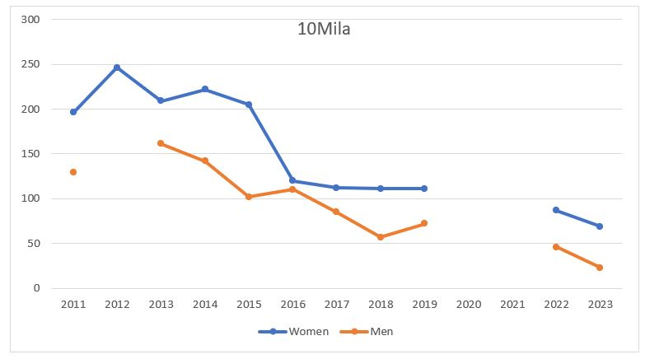
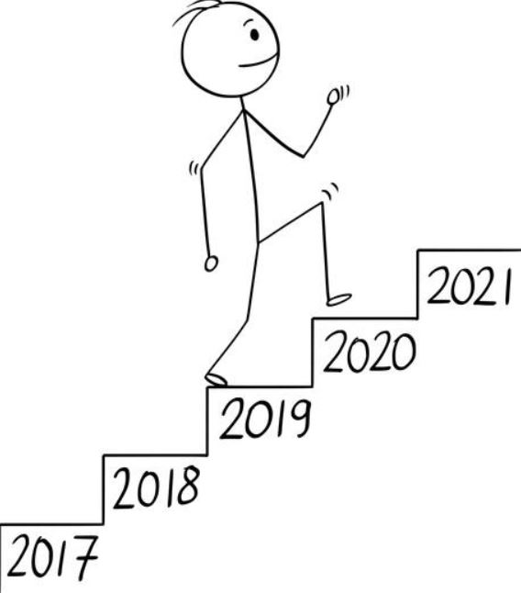
Recent years in 10mila
Women and Men improving year for year
Still a big step to take for both down to our goal

Slide 7
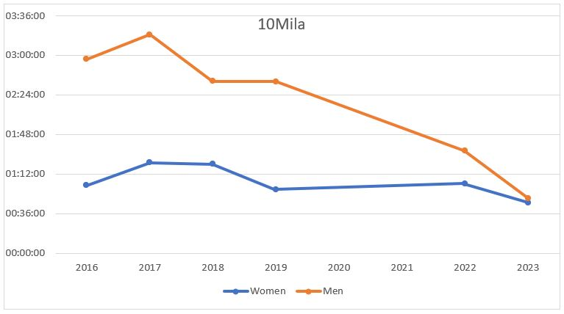
Recent years in 10mila
Time behind winning Team

Slide 8
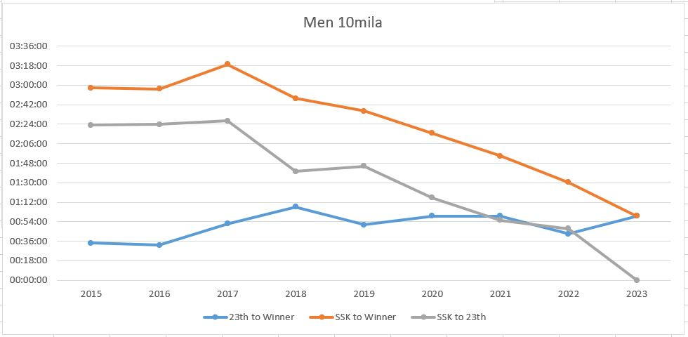
Recent years in 10mila

Slide 9
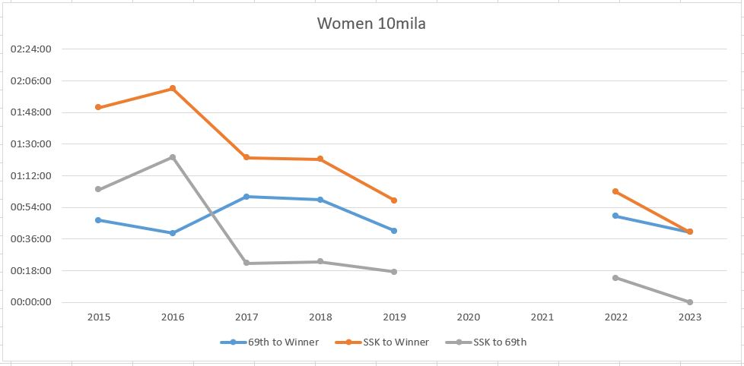
Recent years in 10mila

Slide 10
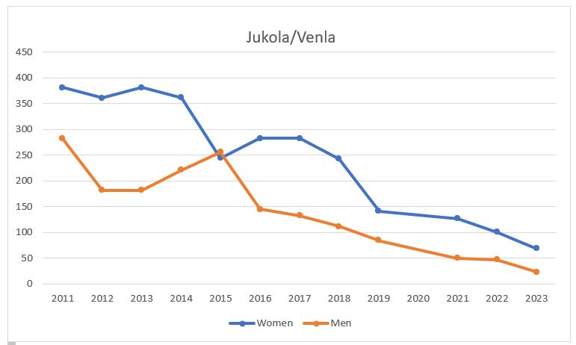
Recent years in Jukola/Venla
Big and constant improvements for both Women and Men every year

Slide 11
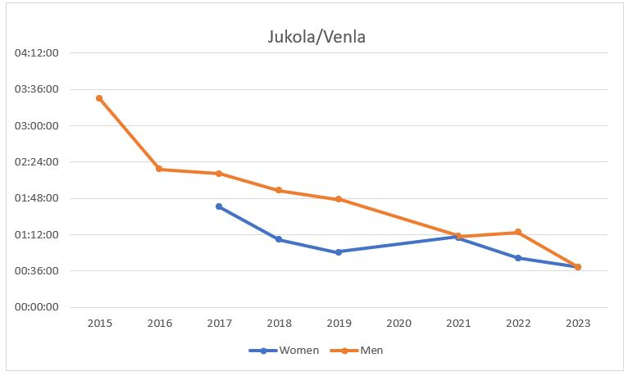
Recent years in Jukola/Venla
Time behind the winning Team

Slide 12
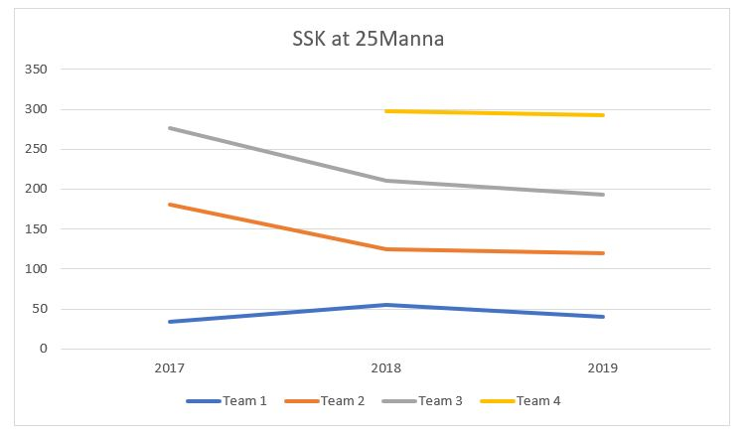
Recent years in 25manna

Slide 13
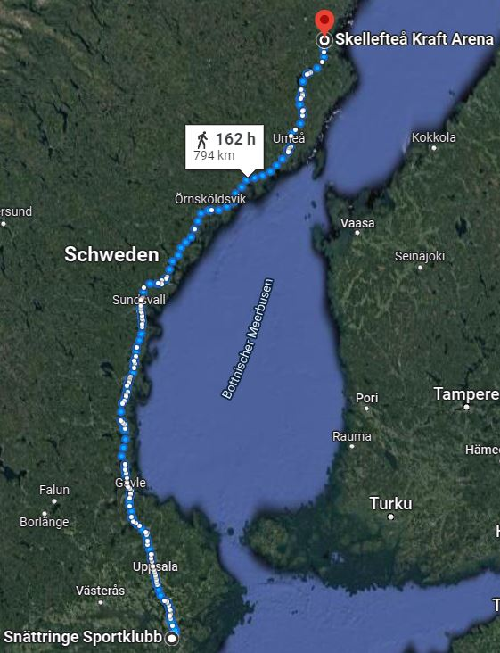
Training goal
SSK Club House – Skellefteå = 794km
24 weeks until 10mila 2023
1st and 2nd team running there and back
(else «only» run there)
-> (2 x 794km)/(24 weeks) = 66.167km/week
maps.google.com

Slide 14
Training topics
Every 2nd week there will be a new training main focus until 10mila 2023
Date | Topic
5. Dec-18.Dec 2022 | Startblocket
19.Dec-1.Jan 2023 | Styrka/Power
2.Jan-15.Jan 2023 | Uthållighet
16.Jan-29.Jan 2023 | Orienteering Basics
30.Jan-12.Feb 2023 | Uthållighet
13.Feb-26. Feb 2023 | Fart
27.Feb-12.Mar 2023 | Nattorientering
13.Mar-26.Mar 2023 | Finslipa tekniken
27.Mar-9.Apr 2023 | Tävlingsförberedande
10.Apr-23.Apr 2023 | Performing
24.Apr-7.Maj 2023 | Tänka rätt (Mental training)
8. Maj-10mila (20maj) 2023 | Formtoppa

Slide 15
Can you contribute? Yes!
Are you good in setting courses?
Are you keen to support us during a big relay?
Can you arrange a training or motivate others to join the trainings?
Do you have other skills we dont know about and that could help us?
Feel free to contact us!

Slide 16
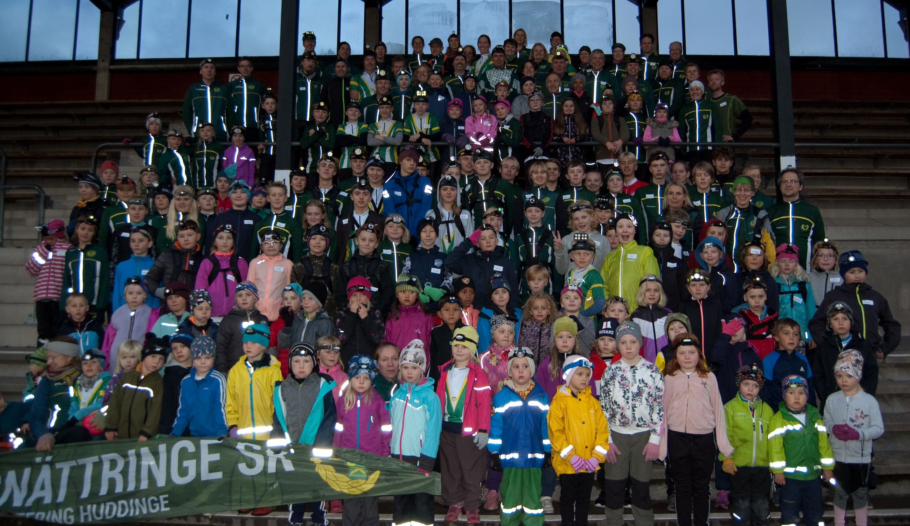
End Part 1 / Thank you for listening!
A high goal requires everybody to work hard towards it

Slide 17
STORM introduction
It is easier to work structured and successful if you know exactly what to work on:
STORM to Topp232023 | Goal (what to work on) | How to achieve it
Surroundings
Team
Orienteering
Running
Mental
I am good at: weaknesses:

Slide 18
Injury prevention
Eat enough!
2. Change running shoes. And running surface

Slide 19
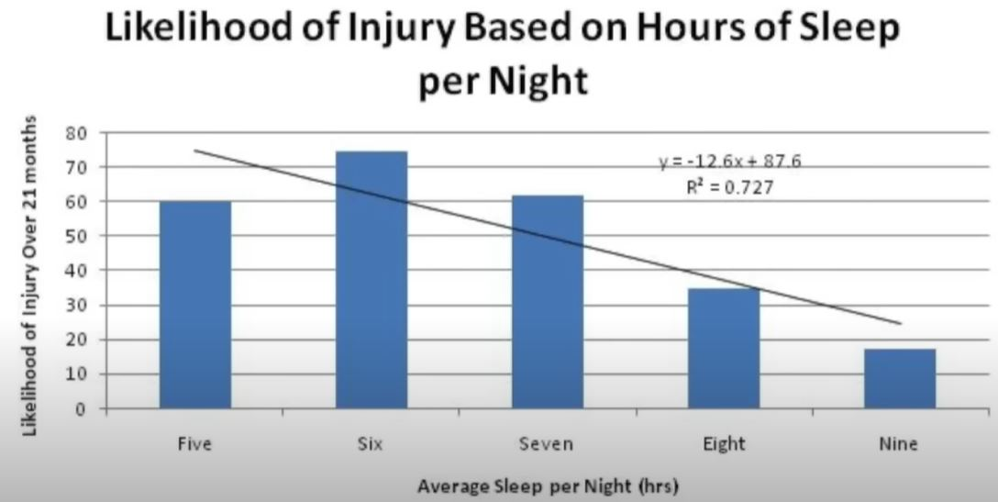
Injury prevention
3. Work on your weaknesses, usually things you don’t really like to do and you are not very good at
4. Get enough sleep!

Slide 20
Injury prevention
5. Add cross training. Like cycling, aqua jogging, cross country skiing. Sports that have not so much impact on your skeleton and such. As Bonus you also can switch easier to those and enjoy them more once you need to reduce running a bit.
6. Train at the right speed. Put your EGO away and run in the speed you are supposed to, and at the moment capable of. Consistency will be higher if you stay motivated and can keep up with your training plan because you are fully rested for the next training again.
Training happens mainly during the time you don’t train. There your body adapts and adjusts. So, give him enough rest and energy (food) to do it as fast and good as possible. So you are ready for the next training session
Sleep
Eat
Train smart
Less injuries
Success

Slide 21
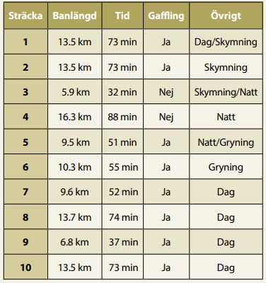
Selection criteria relays
The Men UK has decided to approach this years selection criteria as follows:
We did try to see which leg suits which runner best, so you see where you have a chance to make the team and what to mainly focus on.
Show us, that this leg we think suits you best, really suits you best.
We plan to talk with each runner seperatly about what we think suits best for him and where we think he can help the team most to reach our high goal

Slide 22
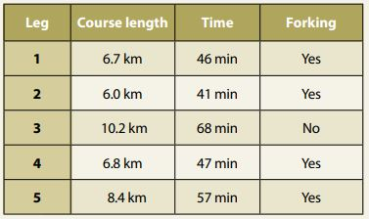
Selection criteria relays
The Women UK would like that you show your interest to run the relay on eventor.
Link will be spread soon.

Slide 23
Financial support
Age defines to some extent what kind of support you get (more discount if you are below 27 and student)
Support on the big relays
SSK support with roughly 60-80% of cost.
800 SEK cost for 10 Mila long weekend
500 or 1000 SEK cost for Jukola
Support SWE-League or SM
500 SEK cost no matter how expensive the trip is
Start fee big 5-6 Day competitions Elit Runners
Support for exile runners at an adhoc basis
50% discount on Idre läger (with UltraSM)
66% discount on Winter training start Camp

Slide 24
What can we expect: 10mila
Tiomila 2023:
”Terrängen består av härligt lättlöpt skogsterräng med mycket god sikt och få områden med löphindrande partier.
Kuperingen är måttlig med inslag av brantare sluttningar med stor detaljrikedom. ... ett antal finfina bergspartier med härligt snabblöpta och tekniskt krävande hällmarker”

Slide 25
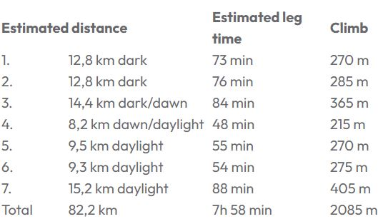
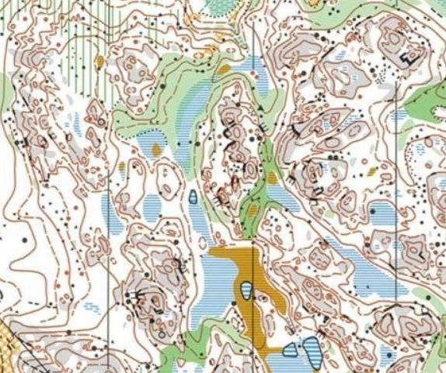
What can we expect: Jukola/Venla
Jukola/Venla 2023:
Bare rock terrain, but less open than last year.
As often in Finland, green areas with controls
Closer to southern Stockholm terrain?!

Slide 26
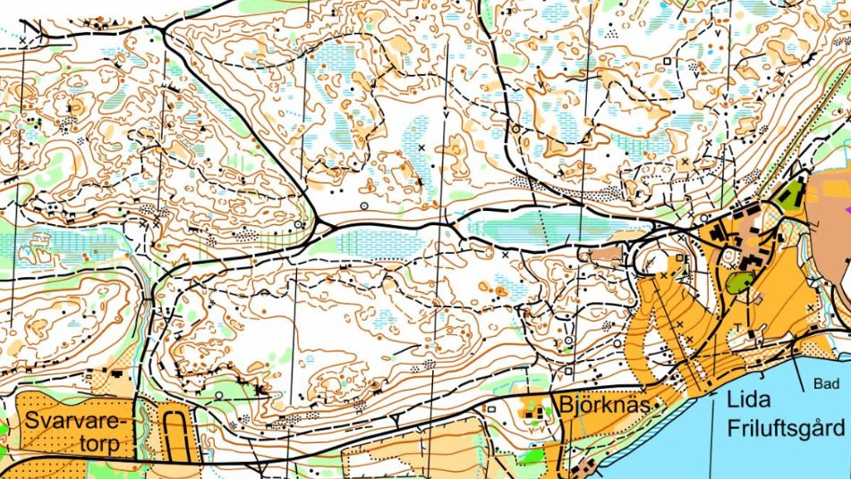
What can we expect: 25manna
25manna:
Lida

Slide 27
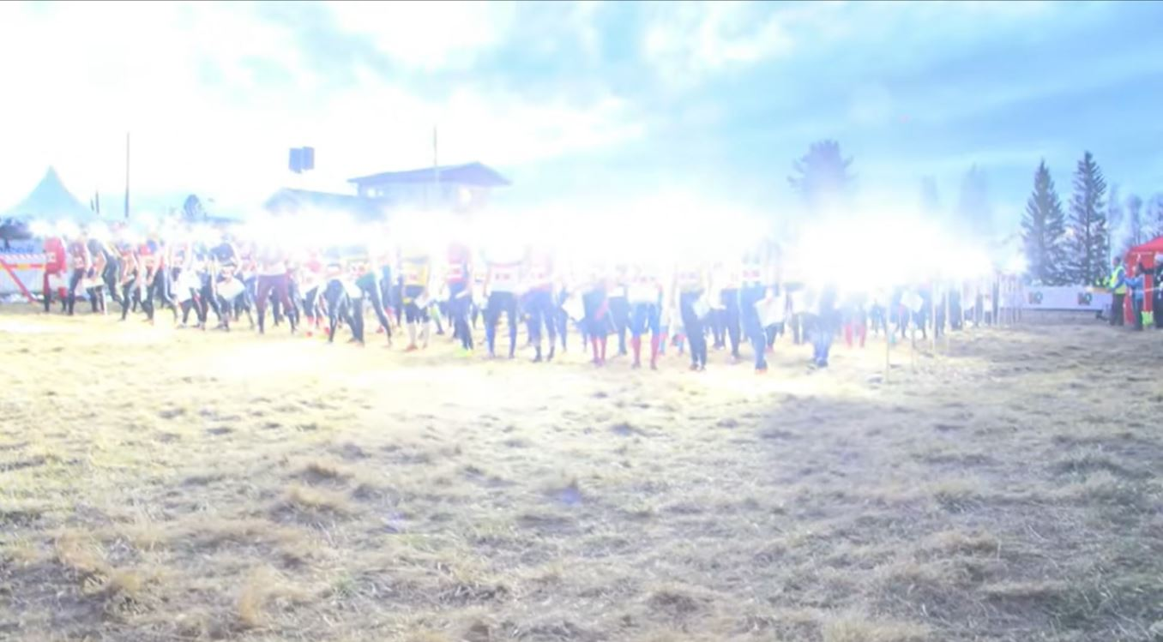
Questions?
Let’s get ready to start TOPP232023!

